Slide 1
EDA Assignment of Bank
Divyanshu Agarwal

Slide 2
Problem Statement
Find Some insight that will help the organization to grow and avoid losses
We need to give some pointers to bank so that they can increase the no of loans applicants and decrease the no of default applicant

Slide 3
Objective
Approve customer who are more like to pay the loan
Business Loss
If the applicant is not likely to repay the loan, i.e. he/she is likely to default, then approving the loan may lead to a financial loss for the company.
Denay the customer who can have difficulty in paying the loan
Capital Loss
If the applicant is likely to repay the loan, then not approving the loan results in a loss of business to the company

Slide 4
Step : Basic understanding of Objective
Then we go through the column description to find out about the DataFrame
After getting the information about the column I then gather knowledge about the columns in that data frame
After understanding the DataFrame then I figure out that in which data frame I should work first or why we started with this.

Slide 5
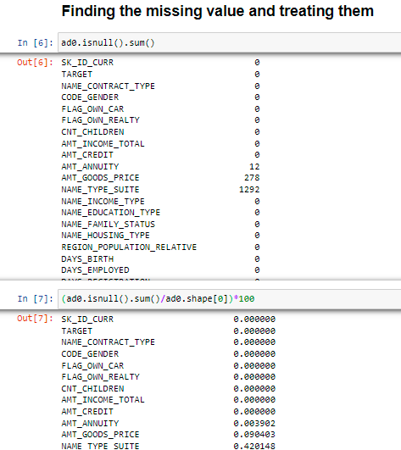
After the basic I am finding the missing value in the Application data Frame After Seeing it in number I see it in % terms

Slide 6
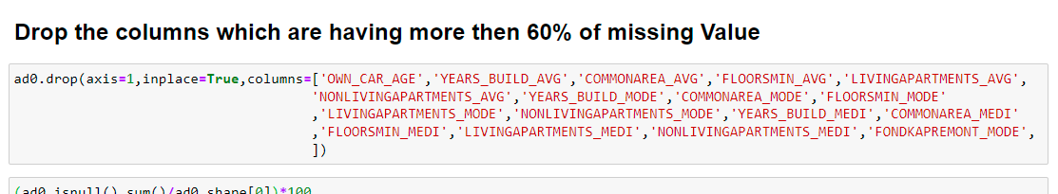
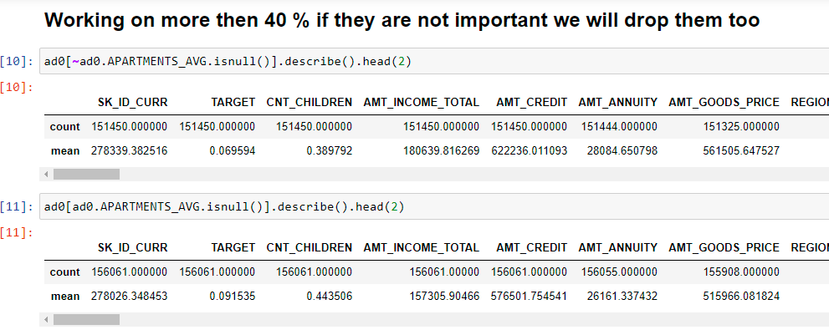
After I see the Missing values I drop those columns that have more then 60 % missing values
Working on the column that have more then 40 % null values

Slide 7
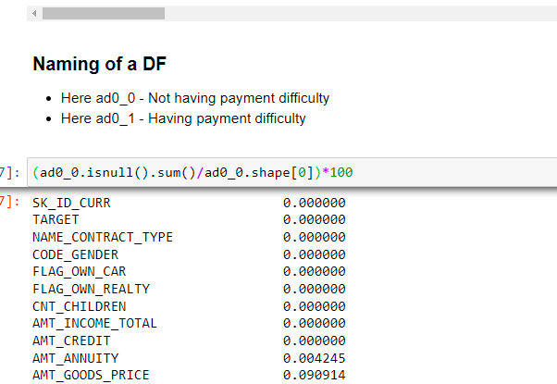
After that I removed the unwanted columns that I won’t use in my analysis or the column that won’t affect the analysis
After removing the columns I fill the missing values and for those values I have gone through so much data and fill the relevant data in those places but only those which are same or common
After that I divide the DataFrame into 2 set based on the Target variable
1 People who have no difficulty in paying the loan
2 People who have difficulty in paying the loan

Slide 8
After dividing the DataFrame into 2 segments then fill all the values such that they can be come under same category
But that didn’t help much in my analysis but they are little bit more accurate then the doing all the thing in a single DataFrame
Few Key Points
1 By splitting the data we try to see the user behaviours
2 Most of the data was coinciding but there is some different also

Slide 9
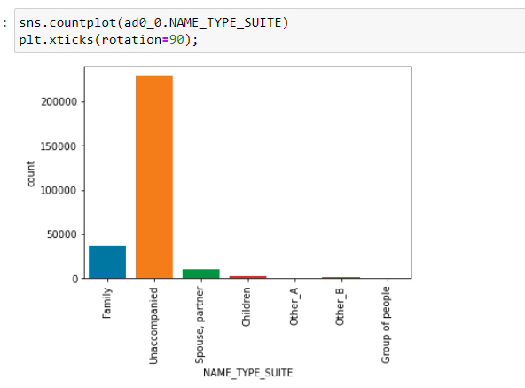
After that if the values were missing then we take the relevant step to solve the missing values for both people who are having difficult and who are not having
Here we see more then 75%
Belong to same category
So we having given null values
Also same Unaccompanied

Slide 10
Lets Sum-up this much so that we can go forward
Find missing values
Drop Columns
Add missing values
Plotting graph
Finding the correct approach for the missing values
Understanding the outliers
Creating different types of graph to understand better

Slide 11
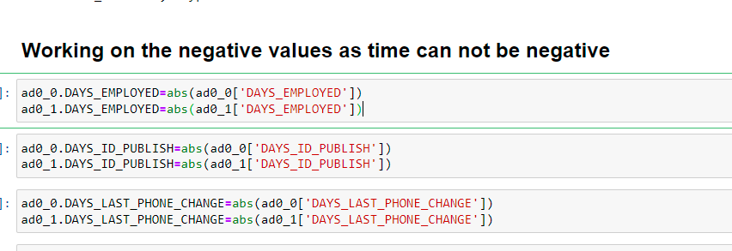
After filling all the missing values then we put the correct values in the columns
Means making the –ve values to +ve values as some values can not be in negative like time.

Slide 12
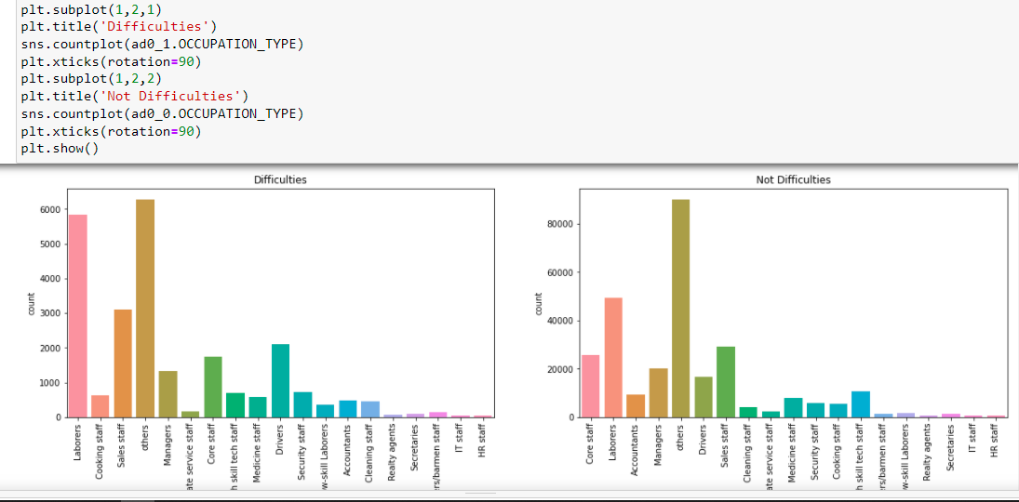
After that we were plotting the graph and driving some useful insight
From the previous chart we can say that most of the people taking loans belong to the labours category
We can also say that out of 40 labours who took the loans
Only 17 are able to pay loan on time
Whereas 23 have struggle in paying it on time
We Came to one more conclusion
That daily wages worker are more
likely to apply for loans as compare
to other
We grow to more secure job then
the people applying for loans reduces

Slide 13
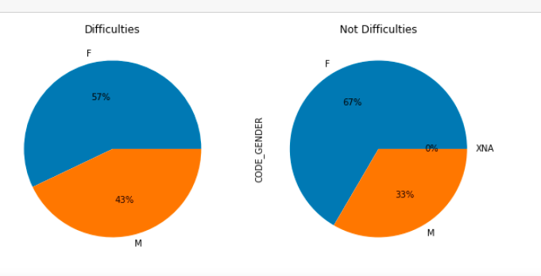
From the pie chart we understand :
female have 2 times less difficulty then man in paying the loans
Therefore women are more secure and the rate in which they have difficulty is around 57%

Slide 14
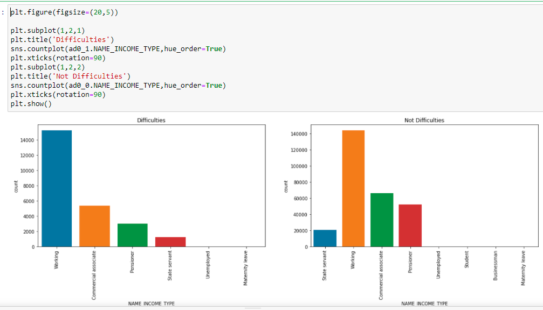
Form the graph we can say:
1 Businessman does not have any issue with payment but have less data to be certain
2 Pensioner have less difficulties
3 Workers population have much difficulty in payment but no says that are the ones who require most number of times loans

Slide 15
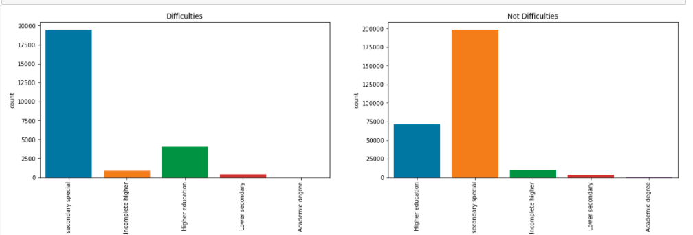
Higher education are less difficulty where as Secondary / secondary special have little more difficulty

Slide 16
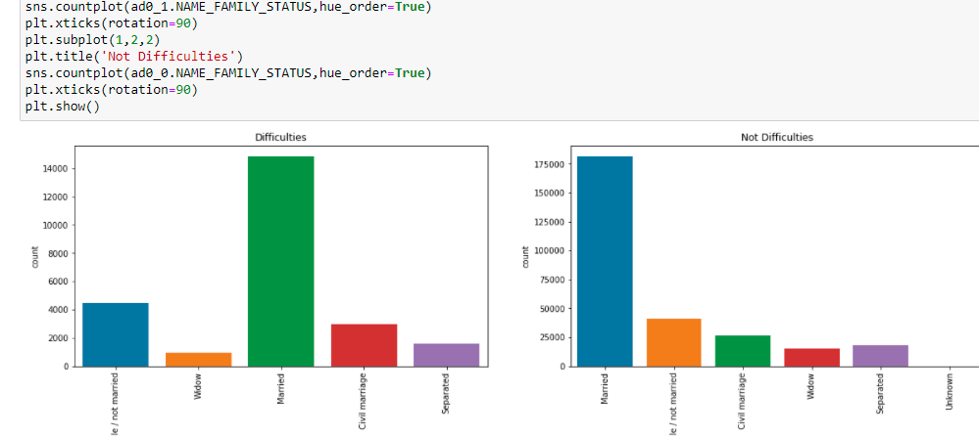
Married people have less difficulty. Single have little more difficulty

Slide 17
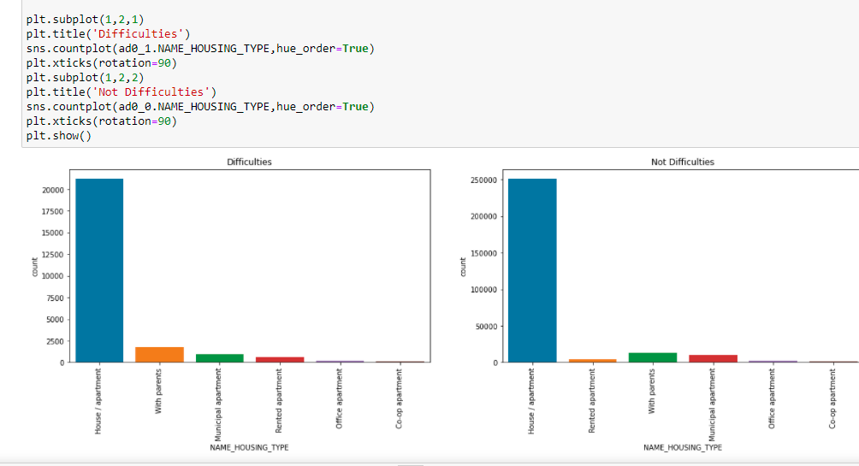
House Type
We can see most people have their own house or a flat.

Slide 18
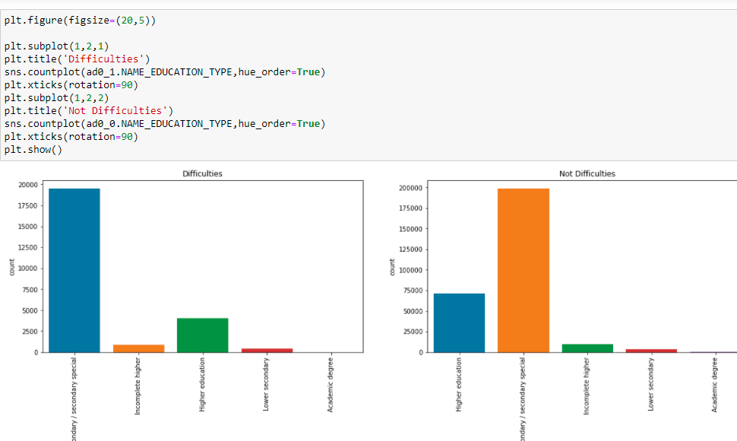
Education Columns
We can see that incomplete education is more problematic.
As most of the loans are taken by Secondary / secondary special people And the higher the education than they takes second highest.
And less education takes less loans or no loans.

Slide 19
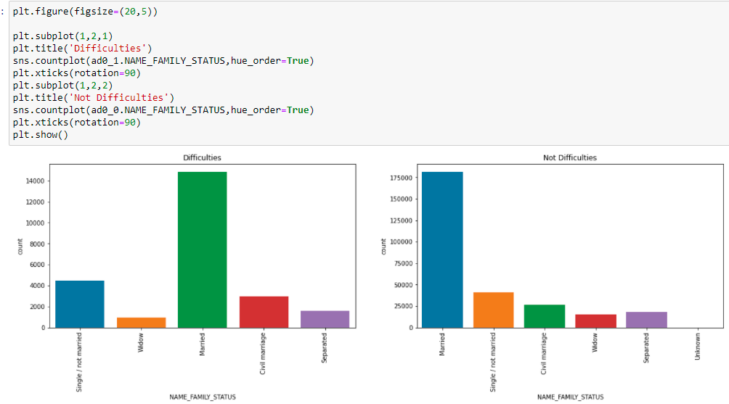
Family Status
We can say that
Married people have less difficulty
Single have little more difficulty
Married people req more loans as compare to others

Slide 20
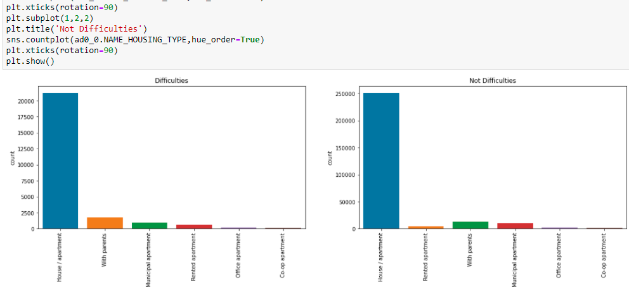
House Type
We can say that most of the loans are taken by people who are having a house or the apartment

Slide 21
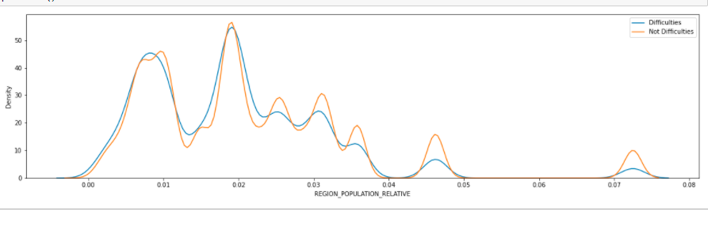
REGION POPULATION RELATIVE:
We can see in the graph the less density then there is the less chance in delaying the payment

Slide 22
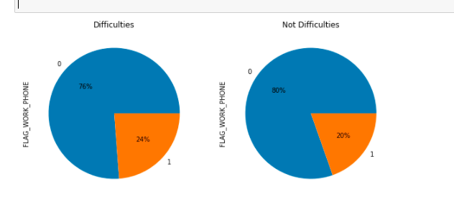
Work Phone :
People who give their work/ office phone number they have little more difficulty in paying the loan.

Slide 23
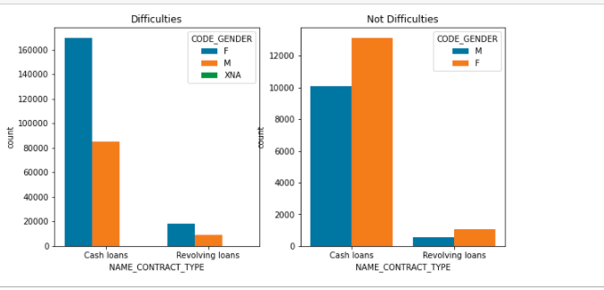
Bivariant Analysis
Loan Type:
Car loans are almost 7 times of revolving loans.
More then 50% of the loan is taken female.
Male have little less difficulty in paying the loan.

Slide 24
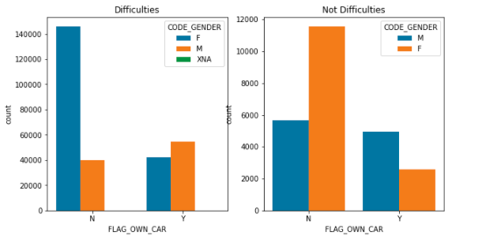
Gender Having Car:
Female who are not having car have 3 times difficulty as compare to male.

Slide 25
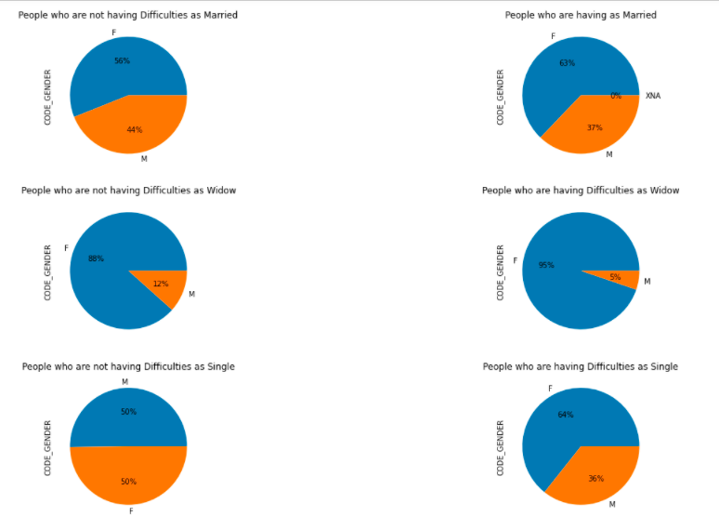
Family Status and Gender Analysis
We can conclude that Female have less problem as compare to male

Slide 26
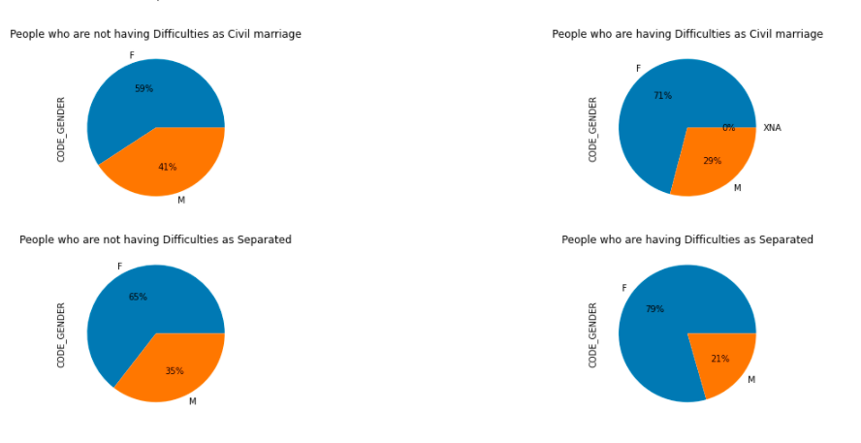
We can conclude that Female have less problem as compare to male

Slide 27
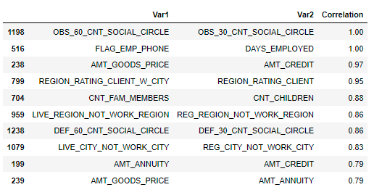
We have merge the the DataFrame to one DataFrame.
We have plot the heatmap of it also to find out the correlation between the different columns.

Slide 28
Working on Previous Application
Same analysis done on it too.
Finding missing values
Drop the columns
Fill the null values
Handling the outliers
And other basic stuff so that we can work on it

Slide 29
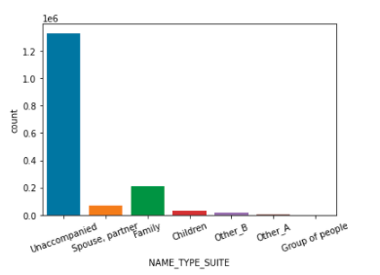
Name Suite
We can clearly see n bank most of the people come alone to take the loan
People come with their family also but the number is at least 6 times less.

Slide 30
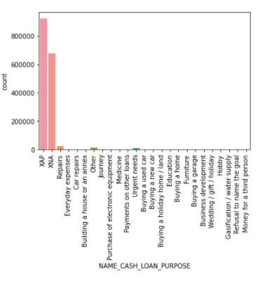
Loan Purpose
A very huge problem we observe is that more then 90% people reason is XAP and XNA we consider it null values.
Bank should ask for the purpose of the loans.

Slide 31
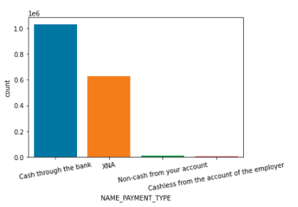
Payment Type
More then 60% people preferred to take payment in cash
More then 35% people they have not mentioned

Slide 32
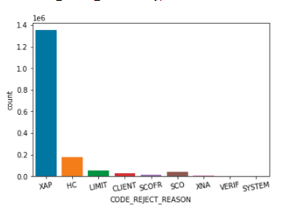
Rejection Type
More then 80% people rejection reason is given XAP
We can conclude that apart from the XPA ,Home Loan are the most rejected application

Slide 33
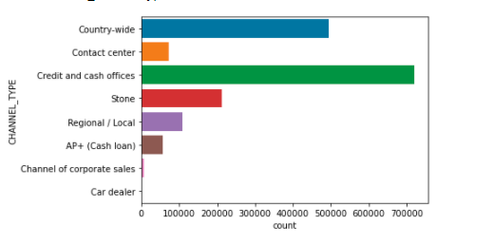
Channel Type
More then 40% people take money via a Credit and cash office

Slide 34
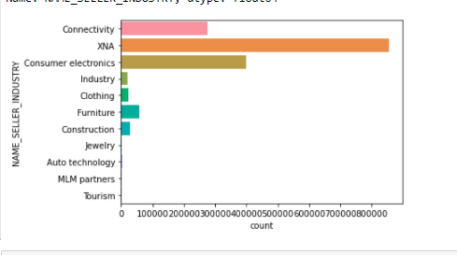
Seller Industry
We can see that more then 50% people belong to XNA category
We can also say that consumer electronics and Connectivity are the biggest category we have

Slide 35
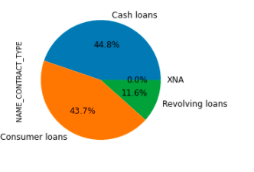
Contract Type
We can clearly see that our major chunk of client belong to cash and consumers category
Therefore we can conclude that business have less trust in our bank as business work via Revolving Loan

Slide 36
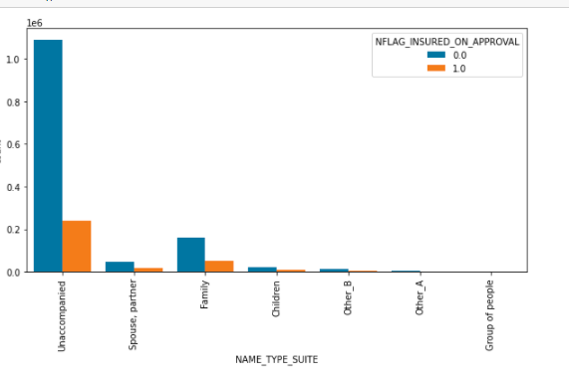
Suite Type
We can clearly say that people who are coming alone have the highest percentage of rejection rate.

Slide 37
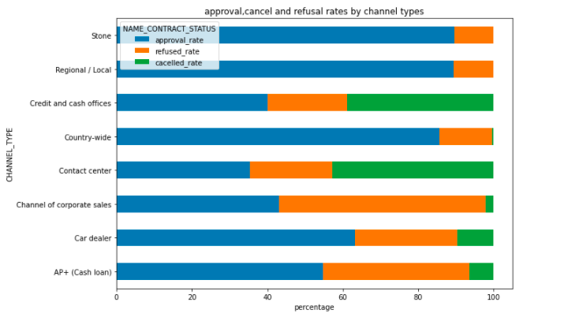
Contract Status and Channel Type
We can clearly see that Stone and Reginal are never cancelled
Cash offices and Contract center have the highest cancelation rate.

Slide 38
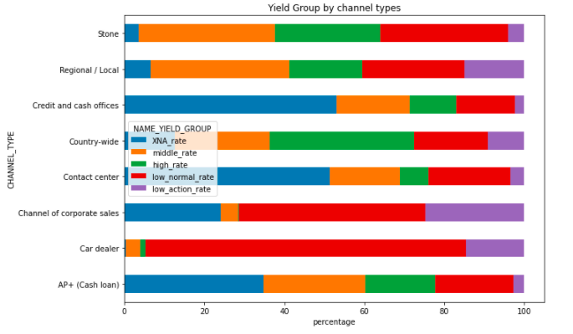
Yield Group and Channel Type
We can see that no car dealer belong to XAN category and they belong to low normal category
We can see that cash loan and contract name have the most XAN catagory

Slide 39
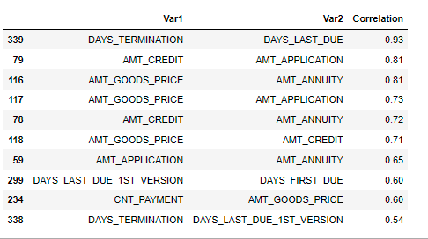
Correlation in Previous Application

Slide 40
Joined DataFrame
After that we have Joined the DataFrame Application and the Previous application DataFrame.
Then we have drop all the duplicates row from the DataFrame.

Slide 41
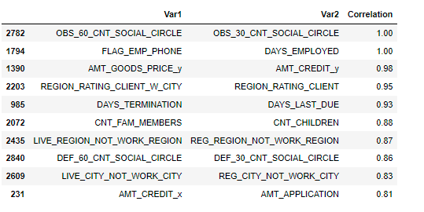
Correlation in Joined DataFrame

Slide 42
From Application data
Where the Loan annuity is more then 20,000 and Loan Amount is more then 2 Lacs then there is a huge drop of Defaulters
From Previous Data
We can say that above 40,000 there is a huge drop of Defaulters
Percentage of Default – 8.2%

Slide 43
Conclusion
Bank give more loans to Female.
Female are more likely to pay the loan as compare to Male.
Most of the loans bank give are belong to XNA and XPA category
Bank should try to give loans to business also as more then 80% loan are cash and car loan.
Most people whose loan reject are people who comes alone in the bank
Most of the loan was given to the Laboure's or can say bank focus on small loans rather then big loans
Therefore more people take cash from the bank as they give loan to the people who take small loan amount.

Slide 44
Conclusion
Bank mostly focus on daily wage people who are not having a strong stable source of income.
Bank most give loans to people who live in a nuclear family
Percentage of Default loan amount is 8.2%

